Slide 1
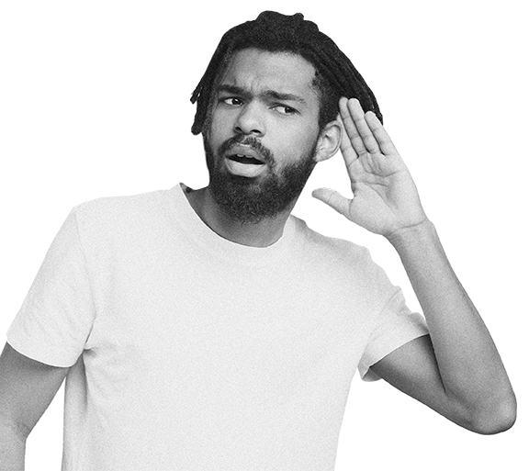
Hate Speech and Offensive Language Text Classification and Clustering
Emanuela Elli (892901)
Federica Madon (825628)
Tommaso Strada (829351)
Text Mining and Search - 2022/2023

Slide 2
About the dataset
The dataset is about tweets that may contain hate speech, offensive language or neither. There are 24783 rows and 6 columns.

Slide 3
Columns
count
hate_speech
offensive_language
Number of CrowdFlower users who coded each tweet
Number of CF users who judged the tweet to be hate speech
Number of CF users who judged the tweet to be offensive
neither
class
tweet
Number of CF users who judged the tweet to be neither offensive nor non-offensive
Label for majority of CF users
Text of the tweet

Slide 4
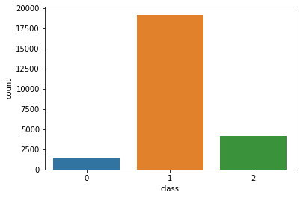

Labels
Hate Speech
"We hate niggers, we hate faggots and we hate spics"
Offensive Language
“RT @HerMoufPiece: Hairy pussy bitch you the type that got herps”
Neither
“Got my vans on.. My pockets chunky”

Slide 5
Framework
01
02
03
Pre
Processing
Text
Classification
Text
Clustering

Slide 6
Pre-Processing
Binary labels
Reduction of label to a binary variable →
type with 1 for hate_speech and offensive_language and 0 for neither of them
Lowercase
Reduction of characters to lowercase
Dropping of urls, mentions, punctuation, emojis, numbers and extra white space.
Removal of repeating characters (more than twice)
Useless Characters
“Amp” & NaN
Correction of a typographical error: “Amp” → “And”
Removal of 2 rows with NaN values
Tokenization
Tokenization of tweets

Slide 7

Before Pre-Processing
"We hate niggers, we hate faggots and we hate spics"
“RT @HerMoufPiece: Hairy pussy bitch you the type that got herps”
“Got my vans on.. My pockets chunky”
After Pre-Processing
['We', 'hate', 'niggers', 'we', 'hate', 'faggots', 'and', 'we', 'hate', 'spics']
['Hairy', 'pussy', 'bitch', 'you', 'the', 'type', 'that', 'got', 'herps']
['Got', 'my', 'vans', 'on', 'My', 'pockets', 'chunky']

Slide 8

Text Classification
Can we distinguish tweets that contain hate speech or offensive language?

Slide 9
Text Classification
Dataset
Text Representation
The dataset is divided in:
70% training set → 17346 rows
30% test set → 7435 rows
Fixing imbalanced classes in the training set with Smote (Synthetic Minority Oversampling Technique) method.
TF-IDF
Word2vec
For using this representation the STOPWORDS are removed in the training set
Using of lemmatization on tweets already divided in tokens
Using of n-grams (unigram, bigram, trigram)
Using of unigram
Google pretrained model
Pre-Processing
Pre-Processing is applied only on the training set. The tweets of the test set are only removed of the punctuation.

Slide 10
Text Classification with TF-IDF
 | XGBOOST | Naive Bayes | SVM
Unigram | Accuracy: 0.74 AUC: 0.89 | Accuracy: 0.84 AUC: 0.93 | Accuracy: 0.78 AUC: 0.90
Bigram | Accuracy: 0.73 AUC: 0.89 | Accuracy: 0.75 AUC: 0.93 | Accuracy: 0.74 AUC: 0.88
Trigram | Accuracy: 0.73 AUC: 0.89 | Accuracy: 0.75 AUC: 0.92 | Accuracy: 0.73 AUC: 0.88

Slide 11
Text Classification with Word2vec
 | XGBOOST | Naive Bayes | SVM
Unigram | Accuracy: 0.95 AUC: 0.98 | Accuracy: 0.90 AUC: 0.92 | Accuracy: 0.95 AUC: 0.97

Slide 12
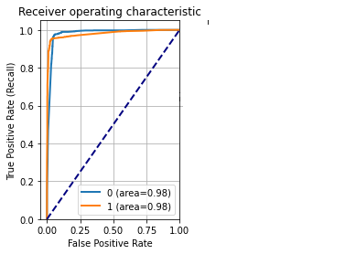
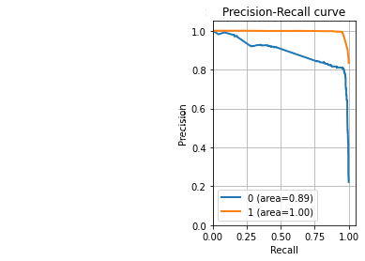
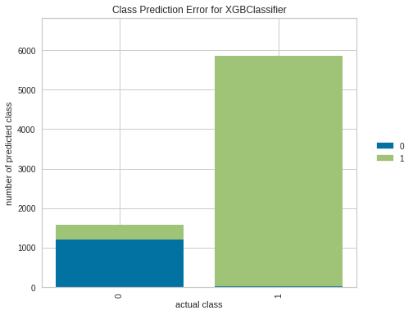
Word2vec - XGBOOST
Results on training set
Results on test set

Slide 13
Text Clustering
Is there any division of tweets into clusters?

Slide 14
Text Clustering
Dataset
A sample is extracted from the dataset. This sample respects the imbalance between the new two classes of the labels.
Text Representation
Word2vec
Pre-Processing
Using of CBOW architecture: size = 300 and alpha = 0.03
Using of n-grams (unigram, bigram, trigram)
Pre-Processing is applied on all the dataset
Tweets are also removed from the STOPWORDS
After tokenization, lemmatization is applied

Slide 15
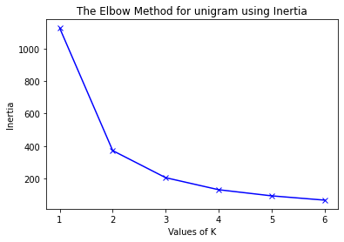
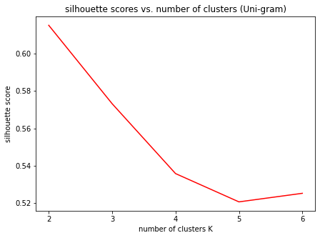
How many clusters?
The Elbow Method and Silhouette Method are computed for each type of n-gram to determine the optimal number of clusters. The plots below are about unigrams.
Elbow Method
Silhouette Method
It turns out that three clusters are the ideal quantity. The results are analog for bigram and trigram.
Notes:
Dire a voce: è stato fatto solo per il k-means e non per agglomerative, per agglomerative si è usato il numero selezionato per il k-means

Slide 16
Text Clustering with Word2vec
 | K-Means | Agglomerative
Unigram | Silhouette index: 0.15 Davies bouldin index: 1.94 | Silhouette index: -0.24 Davies bouldin index: 0.58
Bigram | Silhouette index: 0.74 Davies bouldin index: 0.95 | Silhouette index: -0.59 Davies bouldin index: 0.56
Trigram | Silhouette index: 0.96 Davies bouldin index: 6.41 | Silhouette index: -0.73 Davies bouldin index: 0.55

Slide 17
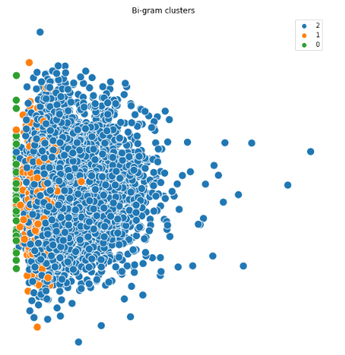
K-means - Bigram
Top 10 most frequent words for cluster 0
[('trash anyway', 3), ('you pussy', 3), ('whipped cream', 2),('he yank', 2), ('shy people', 2), ('female trash', 2), ('next door', 2),
('oreo milkshake', 2), ('hat ghetto', 2), ('could get', 2)]
Top 10 most frequent words for cluster 1
[('street', 9), ('uncle om', 7), ('hoe lol', 6), ('when i', 5), ('fucking retard', 5),
('fucking pussy', 5), ('jig', 5), ('ring', 5), ('unfollow', 5), ('tryin', 5)]
Top 10 most frequent words for cluster 2
[('bitch', 2140), ('i', 1348), ('hoe', 814), ('is', 525), ('like', 517),
('pussy', 401), ('nigga', 350), ('as', 305), ('get', 301), ('but', 282)]

Slide 18
Conclusion
Text Classification
For classification (even if only for unigrams) with the Word2vec representation we get a considerable improvement on the results for our dataset
Text Clustering
The available dataset is probably not suitable for this type of task since the results obtained in terms of metrics seem to be quite satisfactory but visually they do not seem to show particular patterns or features that allow us to clearly distinguish groups of tweets

Slide 19
Future Developments
Validation Test
Dividing the test set into validation and test set with cross validation
Spelling Correction
Using a function to correct spelling mistakes
Normalization
Using a function to normalize all the vocabulary for all the models
N-grams for Word2Vec classification
Implementing Word2Vec classification also with bigram and trigram
Another dataset
Test the chosen model of classification on another dataset with tweets

Slide 20
Relevant Websites:
https://medium.com/@dilip.voleti/classification-using-word2vec-b1d79d375381
https://www.kaggle.com/nlp-model-to-predict-hate-speech#Importing-the-dataset
https://www.kaggle.com/hate-offensive-language
https://github.com/Hate-Speech-Detection
https://medium.com/unsupervised-text-clustering-using-natural-language-processing-nlp
https://ai.intelligentonlinetools.com/ml/k-means-clustering-example-word2vec/
https://www.guru99.com/word-embedding-word2vec.html
Relevant Papers:
Razavi, Amir H., et al. "Offensive language detection using multi-level classification." Advances in Artificial Intelligence: 23rd Canadian Conference on Artificial Intelligence, Canadian AI 2010, Ottawa, Canada, May 31–June 2, 2010. Proceedings 23. Springer Berlin Heidelberg, 2010.
Davidson, Thomas, et al. "Automated hate speech detection and the problem of offensive language." Proceedings of the international AAAI conference on web and social media. Vol. 11. No. 1. 2017.

Slide 21

Thank you for your attention!

